Slide 1
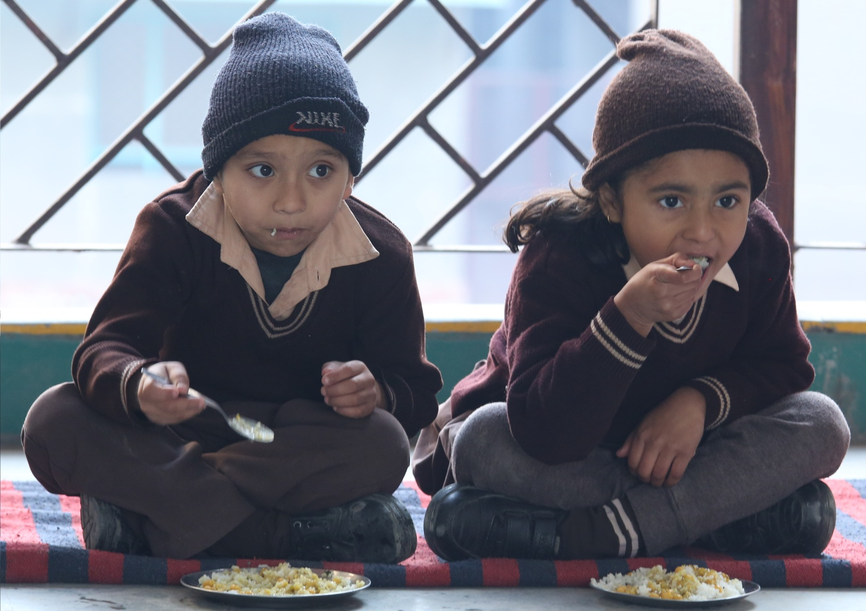
ANNUAL WORK PLAN & BUDGET 2020-21
MDM- PAB Meeting- DELHI on 27.05.2020

Slide 2
INTRODUCTION / BACKGROUND :
Mid Day Meal Scheme is Centrally Sponsored Scheme of Ministry of HRD, Govt. of India.
Cooked Mid Day Meal is provided to the children of primary and upper primary classes of Govt. & Govt. Aided Schools through 60 semi automated kitchens / Service Providers for preparation of meal.
Scheme is implemented by Directorate of Education (Being Nodal Agency) and other five implementing agencies i.e. 3MCDs, NDMC and DCB.

Slide 3
Enrolment ___________________________________________________________________________________
Name of Department | No. of Schools | No of students (I- V) | No of students ( VI – VIII)
DOE & Aided Schools/AIE Centers | 1205 | 157339 | 607303
South MCD | 605 | 260909 | 0
North MCD | 722 | 318297 | 0
East MCD | 463 | 177612 | 0
NDMC | 45 | 130202 | 6922
DCB | 6 | 2040 | 881
Total | 3046 | 929399 | 675106
Total Coverage | 16.05Lakhs

Slide 4
Financial Norms (MHRD)
Food grains from FCI (wheat/rice) @ 100 gms per child per day for primary & 150 gms per child per day for Upper Primary.
The transportation cost of the food grains from FCI Depot to the kitchen @ Rs. 75/- per quintal
Honorarium of Rs. 1000/- per month paid to the Cook-cum-Helpers
(i) Cooking Cost for Primary per Student Rs.4.97/- w.e.f. 01/04/2020
(ii) Cooking Cost for Upper Primary per Student Rs.7.45/- w.e.f. 01/04/2020

Slide 5
Menu of MDM of DoE
Wheat based items: -
1. Atta & Besan Poori with Aaloo Curry/or Mixed Vegetables.
2. Atta Poori with Chholley(mashed vegetables added to the gravy)
3. Paushtik Daliya
Rice based items:-
1. Rice Chholley with mashed vegetables added to the gravy
2. Rice with Sambar/Dal (with vegetables added to the gravy)
3. Rice with Kadhi(with vegetables added to the gravy)

Slide 6
Monitoring
1. School Level MDM Committee has been constituted comprising of HOS, Teacher In-charge MDM, Home Science Teacher, three mothers of students, DDO & one SMC Member for tasting the food before distribution of food among the students.
2. School Management Committee (SMC) also monitor the implementation of the Mid Day Meal Scheme and to ensure that it meets the hygienic standards as specified by the department.
3. Directorate of Education vide circular dated 25/04/2014 has constituted a Grievances Redressal Committee in each District of Education under Sec-32 of the Right of Children to Free and Compulsory Education Act (RTEA) 2009

Slide 7
Monitoring (Cont…)
4. Directorate of Education has engaged the FICCI Research and Analysis Centre for testing the samples of cooked Mid Day Meal and raw food grains w.e.f. February. 2016.
4 samples per month (three from schools and one from kitchen) of each service provider are lifted and tested by FICCI Research and Analysis Center.
One sample of food grain (at the time of lifting from FCI) is also lifted for the testing it’s quality.

Slide 8
Monitoring (Cont…)
From April-2019 to Dec., 2019, 1567 samples were lifted and tested by M/s FICCI Research and Analysis Center. Out of the total 1567 samples collected and tested 1513 samples were meeting norms and 54 samples were below norms. As per the clause of the Agreement signed with NGOs/Service Provider, proportionate deductions have been deducted/imposed on the amount of the bills of Mid Day Meal for that particular day for which sample is collected and found below norms.

Slide 9
New initiatives:
Directorate of Education has empanelled 39 kitchens of NGOs/Service Providers for supplying the Mid Day meal w.e.f 14th October, 2019 (through RFP).
Tender has been floated for empanelment of fresh NABL Accredited Lab for testing of meal.

Slide 10
Coverage under School Health Programme
No. of Students upto 12th
No of schools covered under SHP | Health check up carried out | Distribution of IFA Tablets | Distribu-tion of Vitamin-A Tablets | Distribu-tion of De-worming Tablets | Free Spectacles distributed
3046 | 691379 | 3065960 | NA | 2123307 | 5350

Slide 11
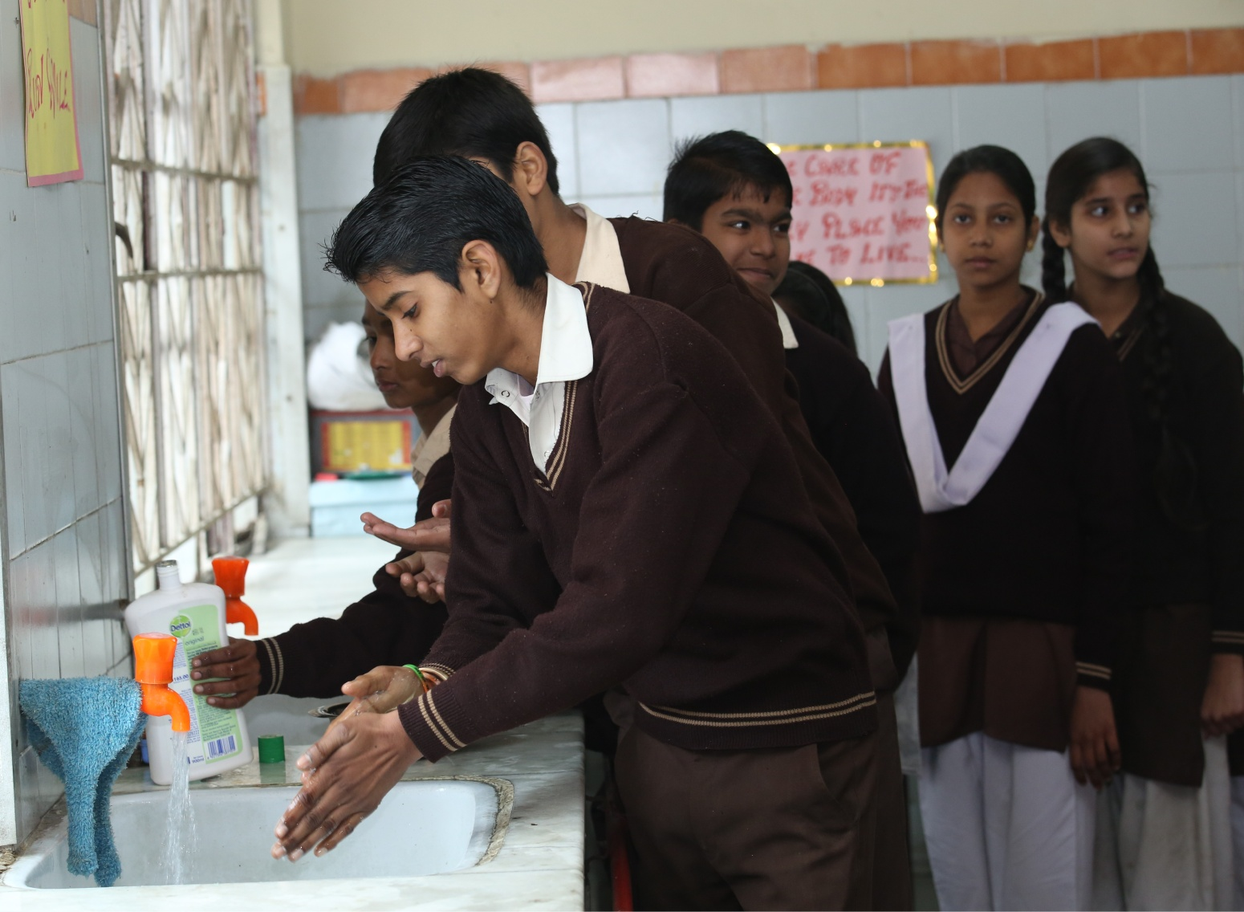
Hand Washing

Slide 12
Action taken 1
School Health Programme (Rashtritya Bal Swasthya Karyakram (RBSK), Weekly Iron & Folic Acid Supplementation, National De-worming Day etc.) and Nutrition in convergence with other Ministries.:-
In this regard health supplement are being given to the school children regularly through Health & Family Welfare, Department.

Slide 13
Action taken 2
Status of implementation of Automated Monitoring System (AMS) :-
At present over all 80% MDM data of all implementing agencies of Delhi
Name of the Agency | Status of schools uploading AMS (Aprox.) | Comments for not/less Uploading
Directorate of Education | 90% | Uploading less by Aided Schools
North MCD | 85% | Due to technical problems.
NDMC | 100% | -----
East MCD | 90% | Due to technical problems.
South MCD | 65% | Due to technical problems
DCB | Not started | Due to technical problems

Slide 14
Action taken 3
Awareness generation activities:
The guidelines / Instruction are circulated to the schools and all implementing agencies regularly
Social Audit:
School Level MDM Committee has been constituted comprising of HOS, Teacher In-charge MDM, Home Science Teacher, three mothers of students, DDO & one SMC Member for tasting the food before distribution of food among the students.
School Management Committee (SMC) also monitor the implementation of the Mid Day Meal Scheme and to ensure that it meets the hygienic standards as specified by the department.

Slide 15
To prevent the spread of COVId-19, the directions were issued to closure of all the schools. Directorate of Education (Nodal Agency) alongwith all the implementing agencies i.e. NDMC, 3 MCDs and DCB has decided that in lieu of hot cooked food which was to be served to the students, Food Security Allowance (Foodgrains + Cooking Cost) may be paid to the students through Direct Benefit Transfer (DBT) into the Bank Accounts of students by using Public Finance Management System (PFMS) Portal. Directorate of Education has already transferred the food security allowance for the Month of March, 2020 through DBT.

Slide 16
State wise details of hot cooked meals or Food Security Allowance (FSA) provided to children during closure of schools due to COVID-19 (from 01.04.2020 to 10.05.2020)
Sl. No. | Primary/Upper Primary | Total days the schools remain closed due to COVID-19 | Number of days MDM or FSA provided to children | Total schools | Number of Schools covered | Total Enrolment | Number of Children provided with
 |  |  |  |  |  |  | Hot cooked Meals | Food security Allowance (FSA)
 |  |  |  |  |  |  |  | Food grains & Cooking Cost | Food Grains & ingredients i.e. pulses, oil etc. in lieu of cooking cost
1 | Primary | 47 (including March.2020) | 27 | 3046 | 3046 | 1604505 (Primary 929399 and 675106 Upper Primary) | Nil | FSA is being paid to 1604505 of students in their account through DBT. | Nil
2 | Upper Primary | 38 (including March.2020) | 27

Slide 17
State wise details of hot cooked meals or Food Security Allowance (FSA) provided to children during Summer Vacations in 2020-21. (From 11.05.2020 to 30.06.2020)
Sl. No. | Primary/Upper Primary | Total days the schools remain closed due to COVID-19 | Number of days MDM or FSA provided to children | Total schools | Number of Schools covered | Total Enrolment | Number of Children provided with
 |  |  |  |  |  |  | Hot cooked Meals | Food security Allowance (FSA)
 |  |  |  |  |  |  |  | Food grains & Cooking Cost | Food Grains & ingredients i.e. pulses, oil etc. in lieu of cooking cost
1 | Primary & Upper Primary | 42 | 42 | 3046 | 3046 | 1604505 (Primary 929399 and 675106 Upper Primary) | Nil | FSA is being paid to 1604505 of students in their account through DBT. | Nil

Slide 18
Expenditure Review 2019-20 (upto December 2019)
Rs. In Lakhs)
S. No. | Component | Release |  | Expenditure |  | Total Release | Total Expenditure
 |  | Central Share | State Share | Central Share | State Share
1 | Cost of Food grains | 441.41 | 0 | 425.9 | 0 | 441.41 | 425.9
2 | Cooking Cost | 5054.71 | 3076.34 | 3770.39 | 2374.3 | 8131.05 | 6144.69
3 | Honorarium to Cook-cum-Helper | 685.3 | 456.87 | 685.3 | 456.87 | 1142.17 | 1142.17
4 | Transportation Assistance | 132.04 | 0 | 86.67 | 0 | 132.04 | 86.67
5 | MME | 170.46 | 0 | 62.08 | 0 | 170.46 | 62.08
6 | Kitchen Devices | 0 | 0 | 0 | 0 | 0 | 0
Total |  | 6483.92 | 3533.21 | 5030.34 | 2831.17 | 10017.13 | 7861.51

Slide 19
Tentative Expenditure upto March 2020
Rs. In Lakhs)
S. No. | Component | Release |  | Expenditure |  | Total Release | Total Expenditure | %
 |  | Central Share | State Share | Central Share | State Share
1 | Cost of Food grains | 735.68 | 0 | 425.9 | 0 | 735.68 | 425.9 | 57.89
2 | Cooking Cost | 8424.51 | 5322.87 | 5436.88 | 5087.03 | 13747.38 | 10523.91 | 76.55
3 | Honorarium to Cook-cum-Helper | 1142.16 | 761.44 | 987.94 | 761.44 | 1903.6 | 1749.38 | 91.90
4 | Transportation Assistance | 220.07 | 0 | 86.67 | 0 | 220.07 | 86.67 | 39.38
5 | MME | 284.1 | 0 | 62.08 | 0 | 284.1 | 62.08 | 21.85
6 | Kitchen Devices | 0 | 0 | 0 | 0 | 0 | 0 | 0.00
Total |  | 10806.52 | 6084.31 | 6999.47 | 5848.47 | 16890.83 | 12847.94 | 76.06
Release (Central) included Rs. 3203.20 lakh, which is authorised and released by Finance Department during 2020-21

Slide 20
Budget Provision for 2020-21
(Rs. In Lakhs)
S. No. | Component | Provision 2020-21 |  | Total
 |  | Central share 60% | State Share 40%
1 | Cost of Food grains | 1044.89 | 0 | 1044.89
2 | Cooking Cost | 9967.29 | 6644.84 | 16612.13
3 | Honorarium to Cook-cum-Helper | 1088.4 | 725.6 | 1814
4 | Transportation Assistance | 313.47 | 0 | 313.47
5 | MME | 335.18 | 0 | 335.18
 | Total | 12749.23 | 7370.44 | 20119.67

Slide 21
THANKS

